Slide 1
Classification of Space Objects Using Machine Learning Methods
Mahmoud Khalil
Dr. Elena Fantino
Prof. Panos Liatsis
Khalifa University
Abu Dhabi, UAE
12 Dec 2019

Slide 2
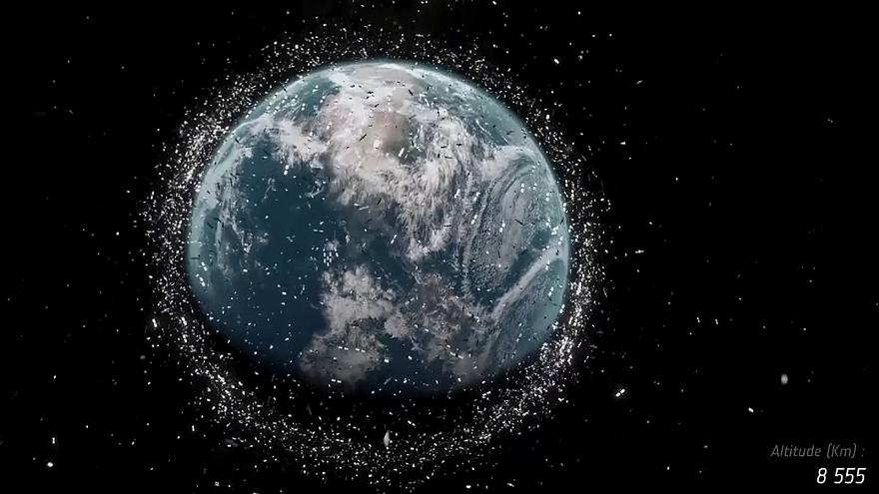
Overview on Space Objects (SOs)
Satellites are used in many applications
Number of space objects is increasing, (and number of collisions)
  over 22,000 as in July 2019 (European Space Agency)
Understanding SO population is important to:
  Identify space objects
  Maneuvering & collision avoidance
Notes:
communications, security, urban planning, environmental data analysis

Slide 3
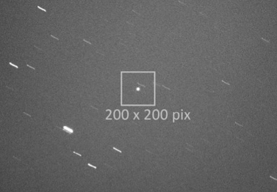
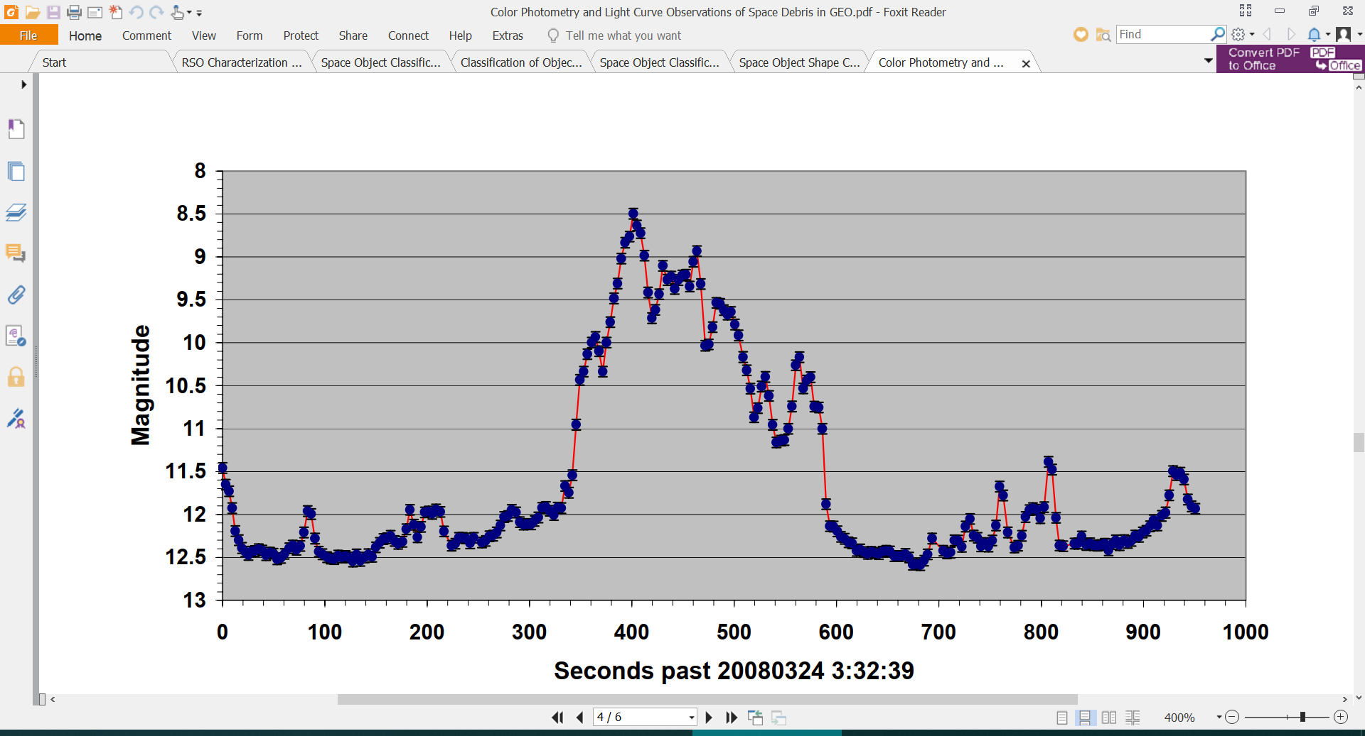
Scanning Space Objects
Scanning is done using cameras, radar, optical sensors
  Radars and cameras are not reliable for small SOs in deep space
Light Curves (Photometric measurements)
  Time series, describe the brightness of an object
  Function of size, shape, attitude, material, atmospheric conditions
  Some of these should be recoverable
  Inverse problem is mathematically complex
  Machine Learning can be used

Slide 4
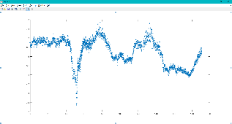
Work Flow
  Classify space objects using Machine Learning techniques
1
Training Machine Learning System
Feature Extraction
Over-sampling
3
Collecting Light Curves
2
PCA
4

Slide 5
Previous Work
Reference | Data | Data Representation | Results | Comments
Singh et. al. 2016 | 200 | Basis Functions | SVM – Perfect classification | Simulated light curve
Howard et. al. 2015 | 6000 | Coefficients from Discrete Fourier Transformation | 0.05 noise → 97% 0.15 noise → 10%-50% drop
Linaris et. al. 2016 | Train / test 45,000 / 5,000 | 1D-CNN | 99.6% on testing set
Furnaro et al. 2018 | Train / test 8,000 / 5,000 | 1D-CNN | 97.83% on testing set 96.4% Bagged-trees 95.3% SVM
Furnaro et al. 2018 | 10,000 | 1D-CNN | 75.4% on testing 63.5% Bagged-trees 53.8% SVM | Real light curves
Bennette et. al. 2017 | 4,317, 109, 5 | coefficients of 3rd order regression line | Acc 98.3%, MCC 0.60

Slide 6
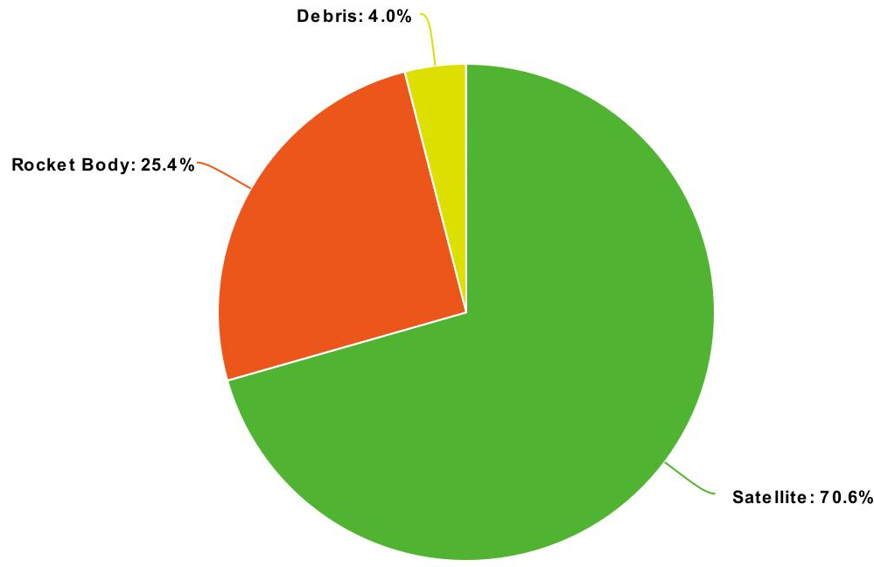
Dataset Setup
Size, category, mass and ID for a set of space objects were collected (DISCOS database)
Light curves for this set of SOs were downloaded (astroGuard website)
Light curves < 200 points → discarded
Total: 747 objects, 16129 light curves

Slide 7
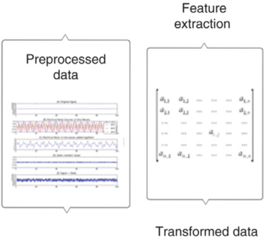
Feature Extraction
feets (feature extractor for time series) python package
  53 features
  Used for classification of light curves of stars.
  Calculates statistical measurements, such as amplitude, mean variance, skewness and standard magnitude.

Slide 8
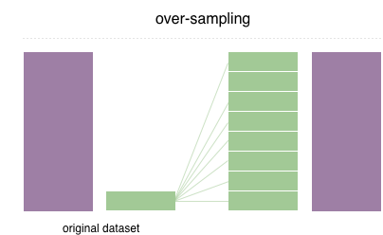
Dimensionality Reduction & Oversampling
Using Principal Component Analysis (PCA)
To reduce size of data
Project original features in a new subspace
Resulting set is ordered in terms of variance
Taking top features ( >99% variance )
Using SMOTE (Synthetic Minority Oversampling Technique)
To solve class imbalance in the data
Generating new samples belong to minority classes

Slide 9
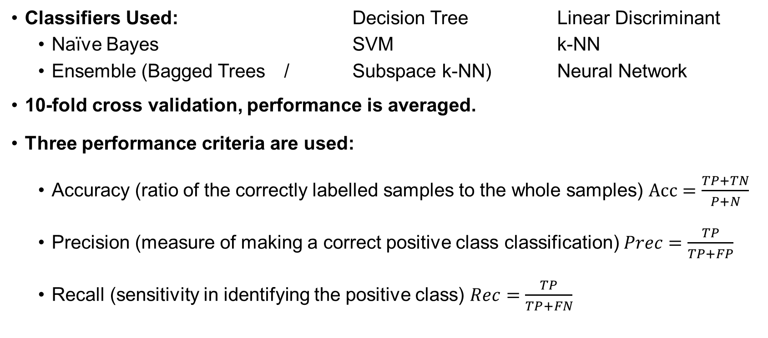
Classification and Results
Space Objects Classification
Classifiers Used: Decision Tree Linear Discriminant
  Naïve Bayes SVM k-NN
  Ensemble (Bagged Trees / Subspace k-NN) Neural Network
10-fold cross validation, performance is averaged.
Three performance criteria are used:
  Accuracy (ratio of the correctly labelled samples to the whole samples) $Acc=\frac{TP+TN}{P+N}$
  Precision (measure of making a correct positive class classification) $Prec=\frac{TP}{TP+FP}$
  Recall (sensitivity in identifying the positive class) $Rec=\frac{TP}{TP+FN}$

Slide 10
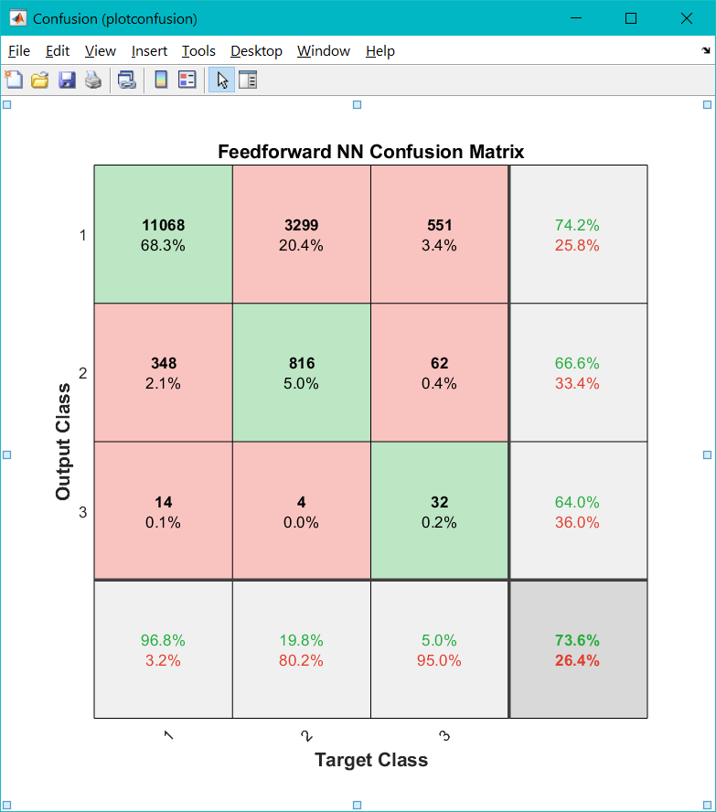
Results
Classify
Satellite
Rocket Body
Debris
Classifier | Original |  |  | Original + PCA
 | Acc | Prec | Rec | Acc | Prec | Rec
Linear Discriminant | 71.2 | 41.3 | 37.0 | 70.5 | 57.0 | 33.8
Decision Tree | 71.0 | 50.4 | 34.9 | 70.5 | 47.5 | 33.4
Naïve Bayes | 55.0 | 38.8 | 39.7 | 67.3 | 39.5 | 35.9
SVM | 72.0 | 85.4 | 35.5 | 70.6 | 90.2 | 33.4
k-NN | 69.7 | 60.9 | 37.0 | 68.7 | 51.4 | 35.2
Ensemble - Bagged Trees | 72.2 | 77.7 | 37.7 | 68.3 | 40.9 | 35.4
Ensemble - Subspace k-NN | 68.8 | 42.7 | 36.2 | 66.6 | 38.7 | 35.3
Feedforward NN | 73.6 | 68.3 | 40.5 | 70.6 | N/A | 33.4

Slide 11
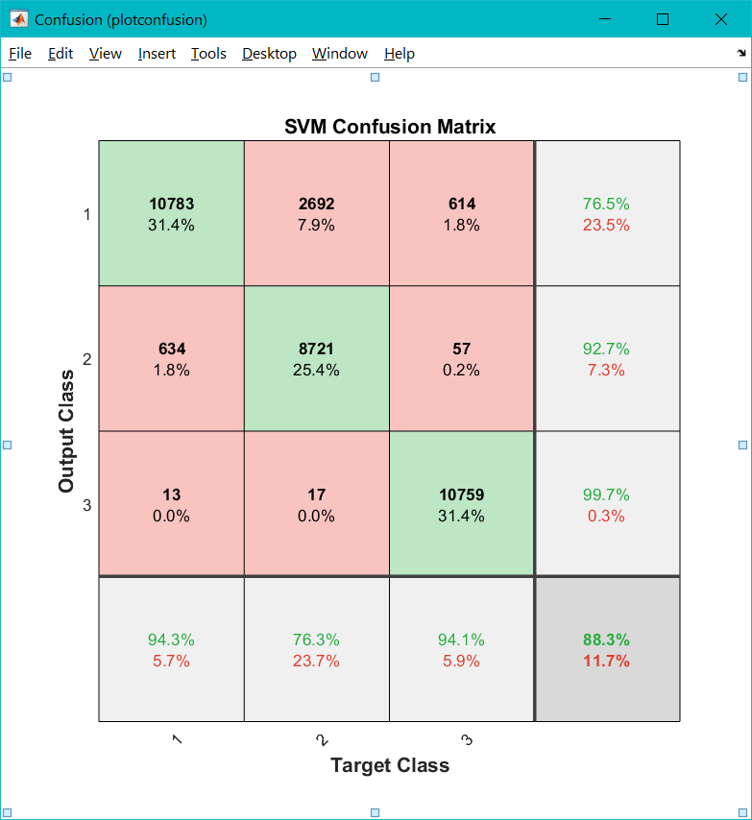
Results
Classify
Satellite
Rocket Body
Debris
Classifier | SMOTE |  |  | SMOTE + PCA
 | Acc | Prec | Rec | Acc | Prec | Rec
Linear Discriminant | 59.2 | 58.9 | 59.2 | 49.6 | 49.5 | 49.6
Decision Tree | 49.6 | 49.3 | 49.6 | 42.8 | 43.0 | 42.8
Naïve Bayes | 49.6 | 50.5 | 49.6 | 45.2 | 44.9 | 45.2
SVM | 88.3 | 89.6 | 88.3 | 51.5 | 51.9 | 51.5
k-NN | 80.9 | 83.1 | 80.9 | 70.3 | 70.2 | 70.7
Ensemble - Bagged Trees | 85.0 | 84.8 | 85.0 | 75.9 | 75.6 | 75.9
Ensemble - Subspace k-NN | 83.3 | 83.7 | 83.3 | 71.0 | 70.7 | 71.0
Feedforward NN | 85.6 | 85.5 | 85.6 | 50.2 | 49.9 | 50.2

Slide 12
Conclusion
  The classifiers were unable to learn most pattern vectors from class 3, which were incorrectly classified as belonging to classes 2 and 3.
  There is a marked improvement in performance for five of ML classifiers, however, performance degraded for the remaining classifiers. There is approximately 15% improvement of the top performing classifier, SVM.
  There is a clear decrease in the average classification performance after using PCA.

Slide 13
Further Work
Different feature extraction methods
Deep Learning approach:
  Convolutional Neural Networks (CNN) – 1D or 2D
  Recurrent Neural Networks (RNN) – LSTM (Long Short-Term Memory)
Addressing class imbalance:
  Cost-sensitive classifiers
  Ensemble models

Slide 14
Thank you

